Slide 1
ECE2810J Data Structures and Algorithms
Minimum Spanning Tree
Learning Objectives:
Know what a minimum spanning tree (MST) is
Know the Prim’s algorithm for finding the MST
Know how the various choices of the supporting data structures affect the runtime of the Prim’s algorithm
Know the Kruskal’s algorithm for finding the MST

Slide 2
Outline
Minimum Spanning Tree
Problem
Prim’s Algorithm
Kruskal’s Algorithm

Slide 3

Tree and Graph
A tree is an acyclic, connected undirected graph.
For a tree, $|E|=|V|−1$.
Claim: Any connected graph with $N$ nodes and $N−1$ edges is a tree.
The tree we see before
However, this is also a tree
Any node can be the root of the tree.

Slide 4
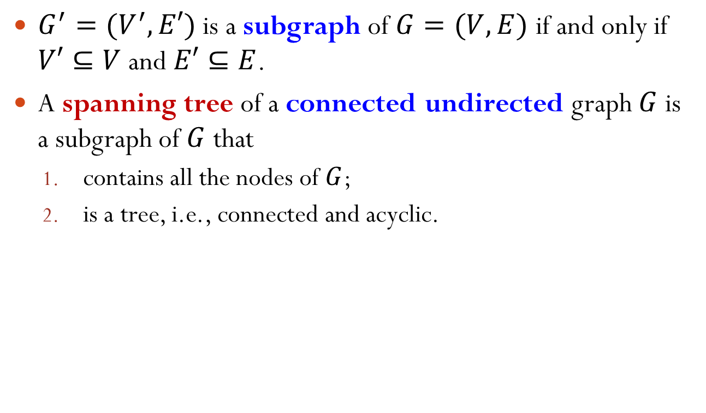
Subgraph and Spanning Tree
$G^{′}=(V^{′},E′)$ is a subgraph of $G=(V,E)$ if and only if $V′⊆V$ and $E′⊆E$.
A spanning tree of a connected undirected graph $G$ is a subgraph of $G$ that
contains all the nodes of $G$;
is a tree, i.e., connected and acyclic.
Spanning Tree

Slide 5
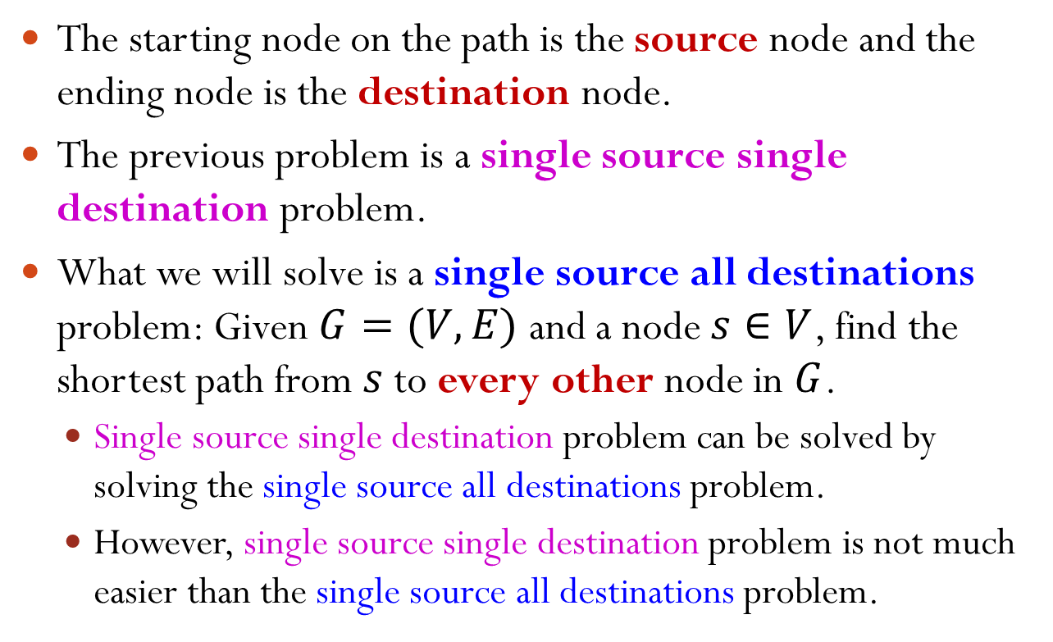
Minimum Spanning Tree (MST)
Given a weighted, connected, undirected graph $G=(V, E)$, a minimum spanning tree $T$ of $G$ is a spanning tree of $G$ whose sum of all edge weights is the minimal.
5
MST
1
1
5
1
1
1
1

Slide 6
Application of MST
A government planning a freeway system to connect all the cities.
A power company planning where to lay down high-voltage power lines.
5
City A
City B
City A
City B
2
MST
1
5
1
1
1
City C
City D
City C
City D
1
1
Notes:
The cost is proportional to the total length of the freeways. Assume once it is connected, it is fine.

Slide 7
Minimum Spanning Tree Algorithms
Main idea: greedily select edges one by one and add to a growing sub-graph.
Two standard algorithms:
Prim’s algorithm
Kruskal’s algorithm

Slide 8
Outline
Minimum Spanning Tree
Problem
Prim’s Algorithm
Kruskal’s Algorithm

Slide 9
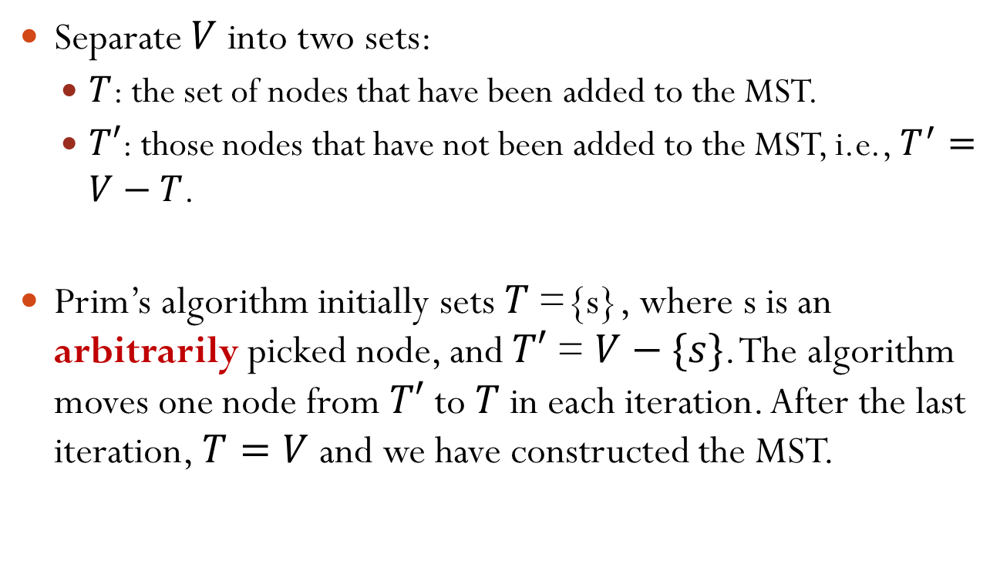
Prim’s Algorithm
Separate $V$ into two sets:
$T$: the set of nodes that have been added to the MST.
$T′$: those nodes that have not been added to the MST, i.e., $T^{′}=V−T$.
Prim’s algorithm initially sets 𝑇 ={s}, where s is an arbitrarily picked node, and $T′$ = $V−\{s\}$. The algorithm moves one node from $T′$ to 𝑇 in each iteration. After the last iteration, $T=V$ and we have constructed the MST.

Slide 10
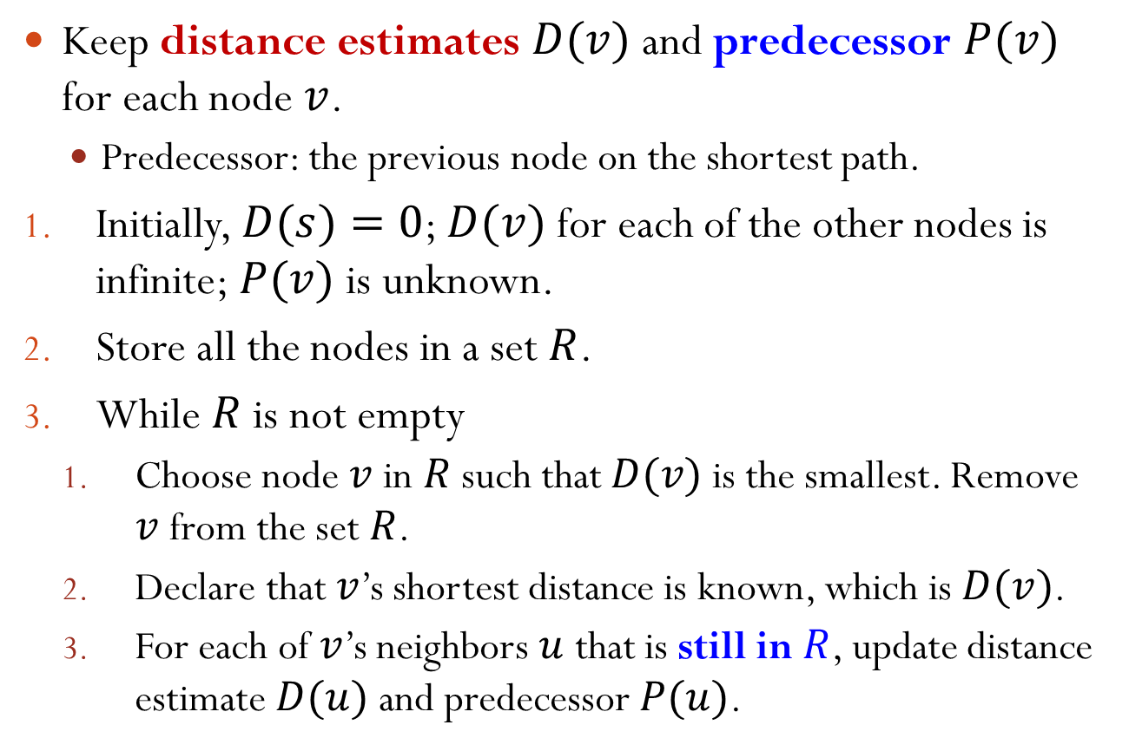
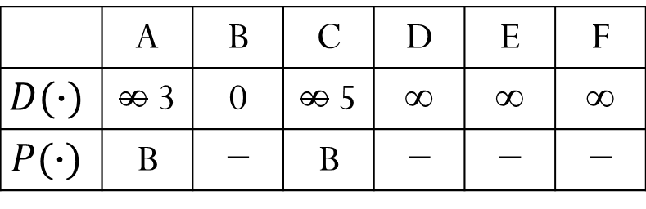
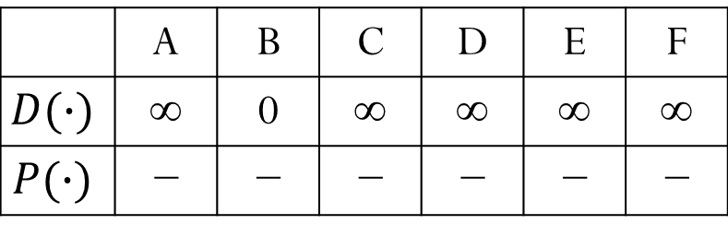

Prim’s Algorithm Basic Version
Arbitrarily pick one node $s$; set $T=\{s\}$and $T′=V−\{s\}$.
While $T′≠∅$
Select an edge with the smallest weight that connects between a node in $T$ and a node in $T′$. Suppose the edge connects with node $v$ in $T′$. Move $v$ from $T′$ to $T$.
$$T$$
5
$T′$
3
…
$$v$$
7

Slide 11
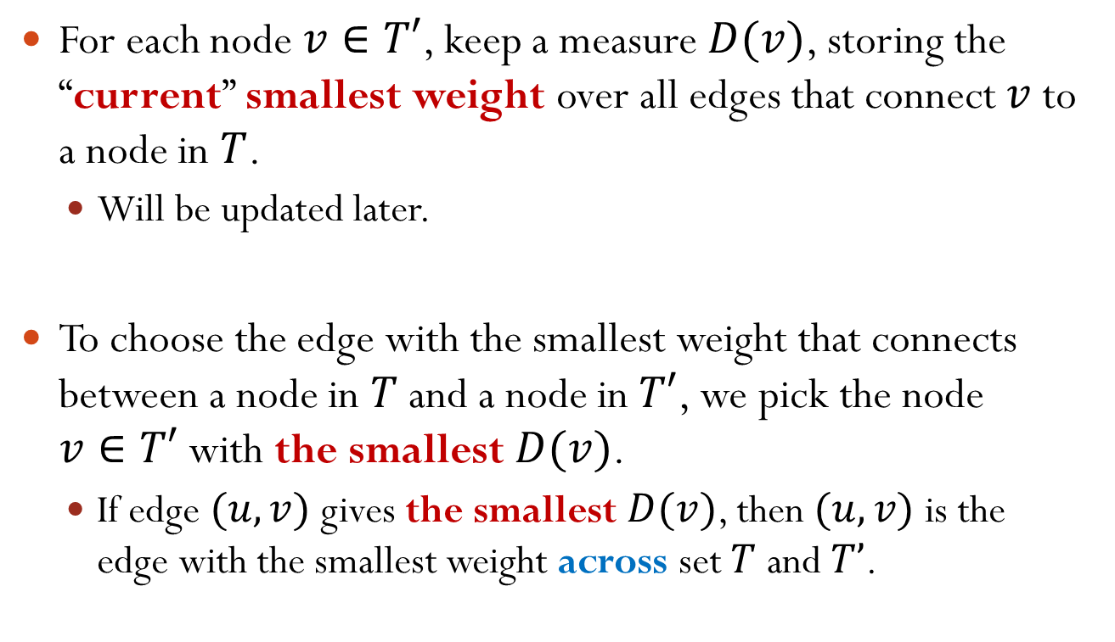
Selecting the Smallest Edge and Node
For each node $v∈T′$, keep a measure $D(v)$, storing the “current” smallest weight over all edges that connect $v$ to a node in $T$.
Will be updated later.
To choose the edge with the smallest weight that connects between a node in $T$ and a node in $T′$, we pick the node $v∈T′$ with the smallest $D(v)$.
If edge $(u,v)$ gives the smallest $D(v)$, then $(u,v)$ is the edge with the smallest weight across set $T$ and $T’$.
Notes:
Note: We only need to focus on D(v) and the corresponding edge for each node in T’, although each node in T’ may have more than one edge connecting to nodes in T.

Slide 12

Updating v’s Neighbor
If we move a node $v$ from $T′$ to $T$, then for each of $v$’s neighbor $u$ that is still in $T′$, we update its $D(u)$ as follows:
If $D(u)>w(v,u)$, then let $D(u)=w(v,u)$.
I.e., update $D(u)$ if the weight of edge $(v,u)$ is smaller than the weight of any other edge that connects a node in $T$ to $u$.

Slide 13
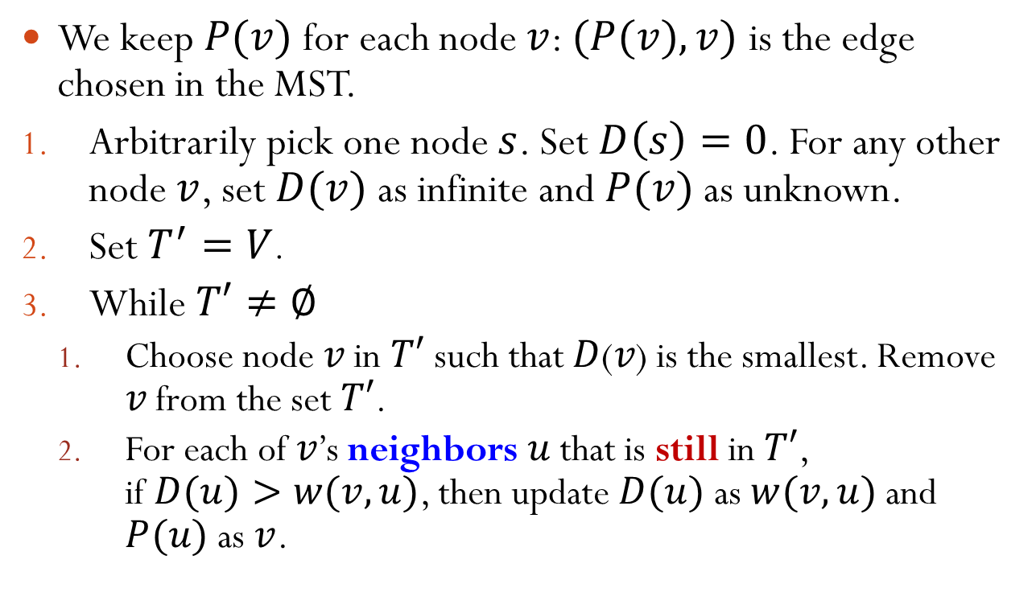
Prim’s Algorithm Full Version
We keep $P(v)$ for each node $v$: $(P(v),v)$ is the edge chosen in the MST.
Arbitrarily pick one node $s$. Set $D\left(s\right)=0$. For any other node $v$, set $D(v)$ as infinite and $P(v)$ as unknown.
Set $T^{′}=V$.
While $T′≠∅$
Choose node 𝑣 in $T′$ such that 𝐷(𝑣) is the smallest. Remove 𝑣 from the set $T′$.
For each of 𝑣’s neighbors 𝑢 that is still in $T′$, if $D(u)>w(v,u)$, then update $D(u)$ as $w(v,u)$ and $P(u)$ as $v$.
Notes:
Before we talk about the algorithm, we would like to mention that we need a additional entry with each node: P(v). It keeps the other end of the edge we have picked.
In the first iteration of the while loop, we will choose v = s.

Slide 14
Prim’s Algorithm Example
3
5
1
5
2
4
5
4

Slide 15
Prim’s Algorithm Example
0
3
5
1
∞
5
∞
2
∞
4
5
∞
4
∞
Notes:
Circle out the set T and T’

Slide 16
Prim’s Algorithm Example
0
3
5
1
3
5
1
2
5
4
5
∞
4
∞
Notes:
Circle out the set T and T’
This ends the first iteration

Slide 17
Prim’s Algorithm Example
0
3
5
1
3
5
1
2
5
4
5
∞
4
∞
Notes:
Circle out the set T and T’

Slide 18
Prim’s Algorithm Example
0
3
5
1
3
5
1
2
2
4
5
4
4
∞
Notes:
Circle out the set T and T’
This ends the second iteration

Slide 19
Prim’s Algorithm Example
0
3
5
1
3
5
1
2
2
4
5
4
4
∞
Notes:
Circle out the set T and T’

Slide 20
Prim’s Algorithm Example
0
3
5
1
3
5
1
2
2
4
5
4
4
5
Notes:
This ends the third iteration

Slide 21
Prim’s Algorithm Example
0
3
5
1
3
5
1
2
2
4
5
4
4
5

Slide 22
Prim’s Algorithm Example
0
3
5
1
3
5
1
2
2
4
5
4
4
5

Slide 23
Prim’s Algorithm Example
0
3
5
1
3
5
1
2
2
4
5
4
4
4

Slide 24
Prim’s Algorithm Example
0
3
5
1
3
5
1
2
2
4
5
4
4
4

Slide 25



Prim’s Algorithm Justification
Claim: the obtained subgraph is a tree
Proof:
The nodes in set $T$ are connected (can be shown by induction)
Furthermore, $\left|V\right|=\left|E\right|+1$
Claim: Any connected graph with $N$ nodes and $N−1$ edges is a tree
$$T$$
5
$T′$
3
…
7

Slide 26













Prim’s Algorithm Justification
Claim: the obtained subgraph is an MST
Proof by contradiction:
Assume the MST does not contain the cheapest edge $e$ between $T$ and $T′$
Assume $e=(u,v)$. Its weight is $w$
In the MST, there exists a unique path between $u$ and $v$. On this path, there is an edge $f$ across $T$ and $T′$. Its weight $>w$
We replace $f$ by $e$ in original MST.
The new graph is a tree (Why?) with smaller sum of edge weights
$T$
5
$T$
5
$T′$
$T′$
$e$
$e$
$u$
3
$u$
3
$v$
$$f$$
7
$v$
$$f$$
7
Notes:
Why the new graph is a tree? It is connected. (For original path which goes through f, now it changes and goes through e.) Original graph satisfies |V|=|E|+1. It also holds for the new graph.

Slide 27
Prim’s Algorithm Time Complexity
Arbitrarily pick one node $s$. Set $D\left(s\right)=0$. For any other node $v$, set $D(v)$ as infinite and $P(v)$ as unknown.
Set $T^{′}=V$.
While $T′≠∅$
Choose node 𝑣 in $T′$ such that 𝐷(𝑣) is the smallest. Remove 𝑣 from the set $T′$.
For each of 𝑣’s neighbors 𝑢 that is still in $T′$, if $D(u)>w(v,u)$, then update $D(u)$ as $w(v,u)$ and $P(u)$ as $v$.
What is the time complexity of Prim’s algorithm?
Notes:
D(v): smallest weight over all edges that connect $v$ to a node in $T$
Steps 1 and 2 are O(V)
The dominant part is the while loop, which happens V times

Slide 28
Prim’s Algorithm Time Complexity
Method 1: linear scan the set $T′$ to find the smallest $D(v)$.
Number of times to find the smallest $D(v)$: $|V|$.
Each cost: $O(|V|)$.
Maximal number of times to update the neighbors: $|E|$.
Since each neighbor of each node could be potentially updated.
Each cost: $O(1)$.
Total running time is $O\left(\left|E\right|+{\left|V\right|}^{2}\right)=O({|V|}^{2})$.
Notes:
Indeed, for using linear scan to find the smallest D(v), it is V+(V-1)+...+1 = O(V^2)

Slide 29
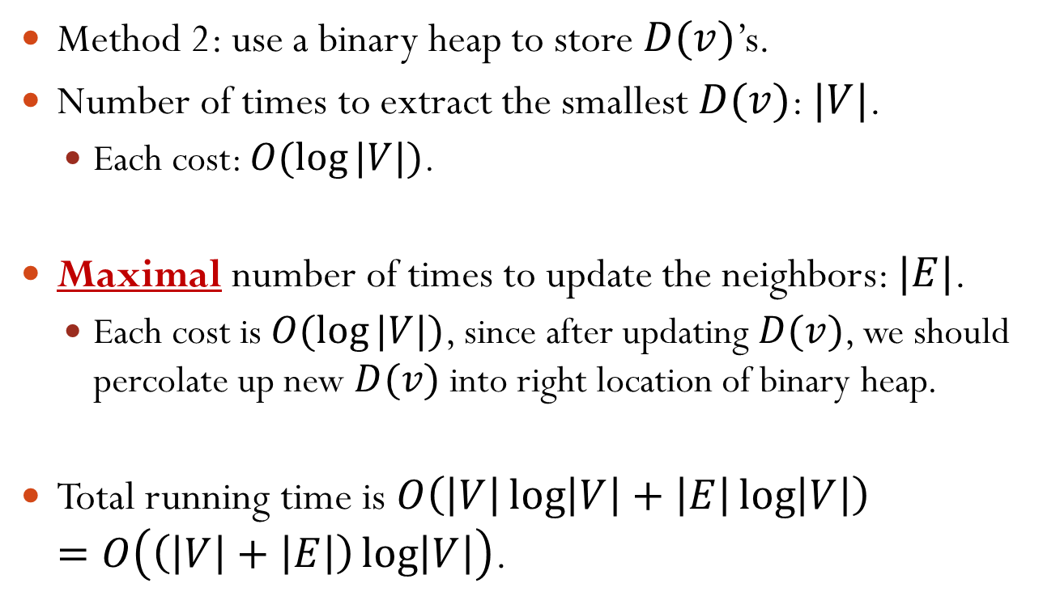
Prim’s Algorithm Time Complexity
Method 2: use a binary heap to store $D(v)$’s.
Number of times to extract the smallest $D(v)$: $|V|$.
Each cost: $O(\log{|V|})$.
Maximal number of times to update the neighbors: $|E|$.
Each cost is $O(\log{|V|})$, since after updating $D(v)$, we should percolate up new $D(v)$ into right location of binary heap.
Total running time is $O\left(\left|V\right|\log\left|V\right|+\left|E\right|\log\left|V\right|\right)$ $=O\left(\left(\left|V\right|+\left|E\right|\right)\log\left|V\right|\right)$.
Notes:
Why percolate up? Because we decrease D(v) if it is updated.
Can we write the final expression as O(|E| log |V|)? No, because the algorithm may be applied to an unconnected graph for which no spanning tree exists.

Slide 30
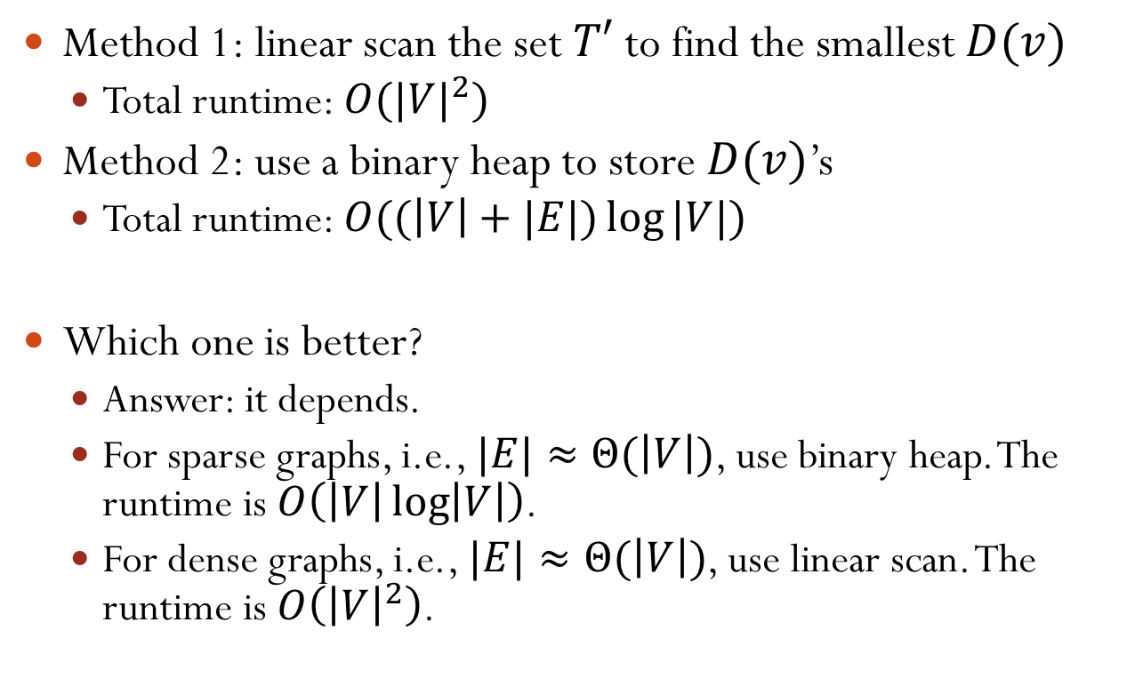
Prim’s Algorithm Time Complexity
Method 1: linear scan the set $T′$ to find the smallest $D(v)$
Total runtime: $O({|V|}^{2})$
Method 2: use a binary heap to store $D(v)$’s
Total runtime: $O((\left|V\right|+|E|)\log{|V|})$
Which one is better?
Answer: it depends.
For sparse graphs, i.e., $|E|≈Θ(\left|V\right|)$, use binary heap. The runtime is $O\left(\left|V\right|\log\left|V\right|\right)$.
For dense graphs, i.e., $|E|≈Θ(\left|V\right|)$, use linear scan. The runtime is $O\left({\left|V\right|}^{2}\right)$.

Slide 31
Outline
Minimum Spanning Tree
Problem
Prim’s Algorithm
Kruskal’s Algorithm

Slide 32
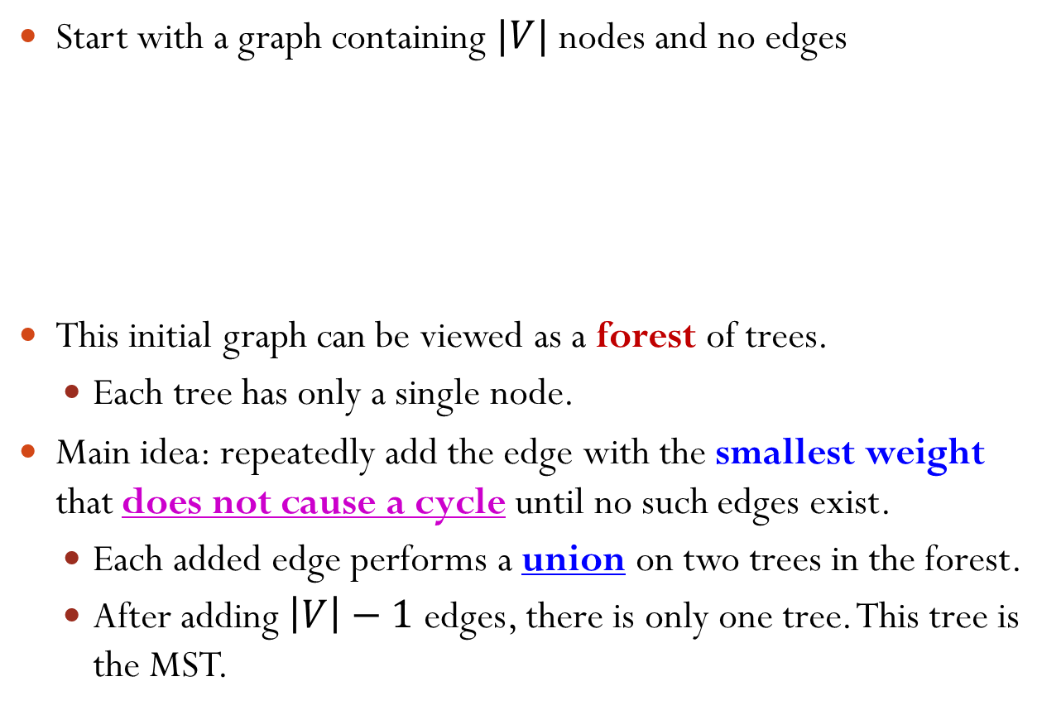
Kruskal’s Algorithm
Start with a graph containing $|V|$ nodes and no edges
This initial graph can be viewed as a forest of trees.
Each tree has only a single node.
Main idea: repeatedly add the edge with the smallest weight that does not cause a cycle until no such edges exist.
Each added edge performs a union on two trees in the forest.
After adding $\left|V\right|−1$ edges, there is only one tree. This tree is the MST.
5
Initial Graph
1
1
5
1

Slide 33
Kruskal’s Algorithm Example
Repeatedly add the edge with the smallest weight that does not cause a cycle until no such edges exist.
A
13
1
8
15
5
B
C
D
3
4
5
E
F
2

Slide 34
Kruskal’s Algorithm Example
Repeatedly add the edge with the smallest weight that does not cause a cycle until no such edges exist.
A
The next edge with the smallest weight is (D, F).
13
1
8
15
5
B
C
D
However, adding it causes a cycle. So it is discarded.
3
4
5
E
F
2

Slide 35
Kruskal’s Algorithm Example
Repeatedly add the edge with the smallest weight that does not cause a cycle until no such edges exist.
A
The next edge with the smallest weight is (C, D).
13
1
8
15
5
B
C
D
However, adding it causes a cycle. So it is discarded.
3
4
5
E
F
2

Slide 36
Kruskal’s Algorithm Example
Repeatedly add the edge with the smallest weight that does not cause a cycle until no such edges exist.
A
The next edge with the smallest weight is (A, C).
13
1
8
15
5
B
C
D
However, adding it causes a cycle. So it is discarded.
3
4
5
E
F
2

Slide 37
Kruskal’s Algorithm Example
Repeatedly add the edge with the smallest weight that does not cause a cycle until no such edges exist.
A
The next edge with the smallest weight is (A, B).
13
1
8
15
5
B
C
D
MST construction done.
3
4
5
E
F
2

Slide 38
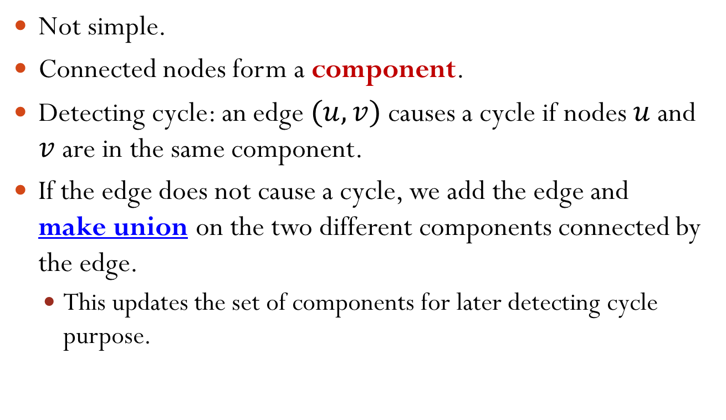
Detecting Cycles
Not simple.
Connected nodes form a component.
Detecting cycle: an edge $(u,v)$ causes a cycle if nodes $u$ and $v$ are in the same component.
If the edge does not cause a cycle, we add the edge and make union on the two different components connected by the edge.
This updates the set of components for later detecting cycle purpose.

Slide 39
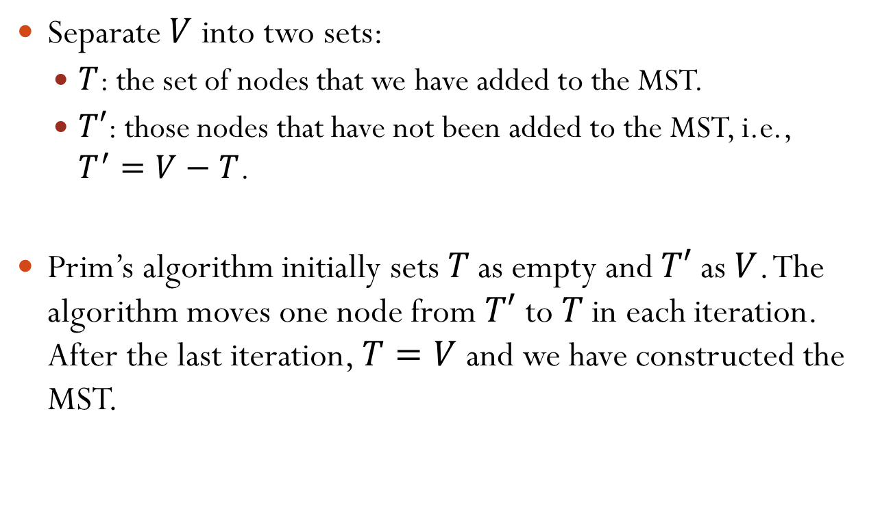
Kruskal’s Algorithm Implementation and Time Complexity
Sorting the edges by weights
Time complexity: $O(\left|E\right|\log{|E|})$.
Detecting cycle. If no cycle, add edge and merge two trees.
Time complexity: $O(\log{|V|})$. (Not covered)
In the worst case, we detect cycles for all edges. The time complexity is $O(|E|\log{|V|})$.
Since $\left|E\right|=O({|V|}^{2})$, the total running time is $O(\left|E\right|\log{|V|})$.

